Slide 1
Design and Analysis of Algorithms
CS602
Lecture 12
Depth First Search in Directed Graph - II

Slide 2
Recap of the last lecture

Slide 3
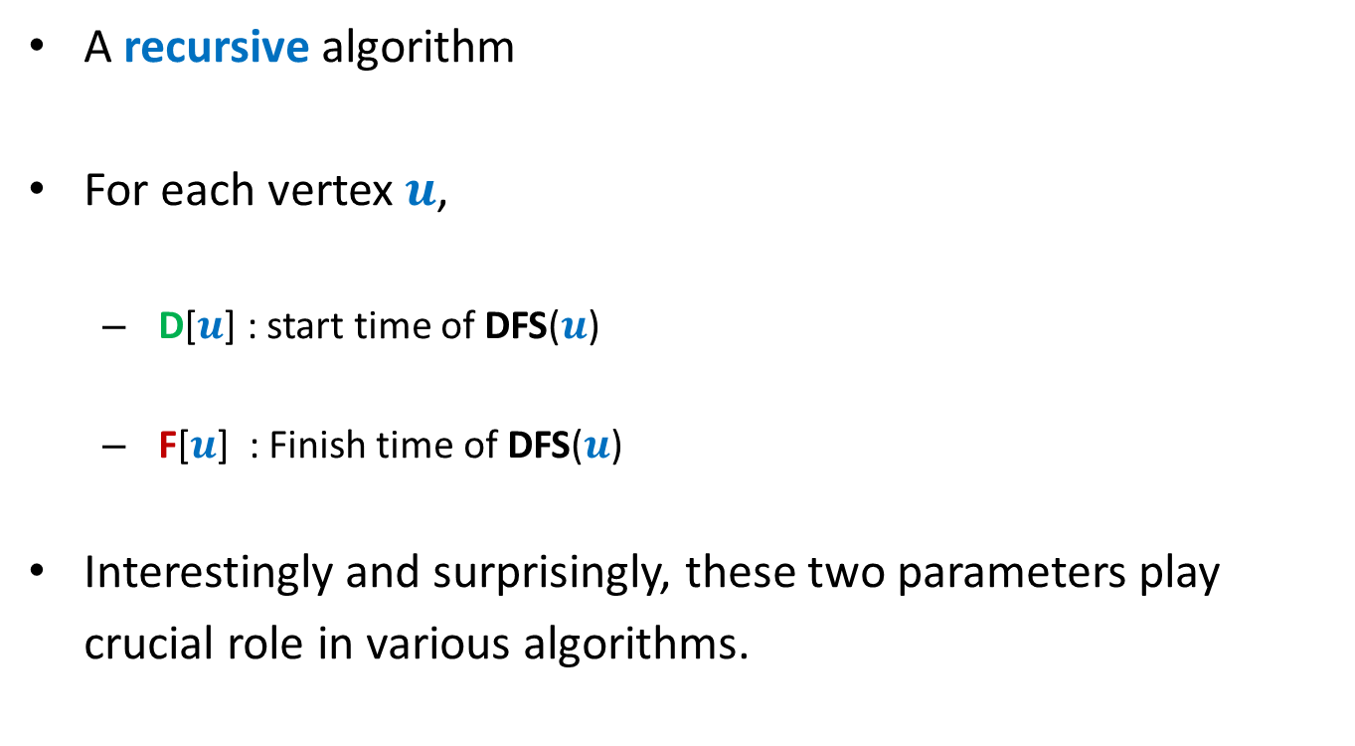
DFS traversal in directed graph
A recursive algorithm
For each vertex $u$,
D[$u$] : start time of DFS($u$)
F[$u$] : Finish time of DFS($u$)
Interestingly and surprisingly, these two parameters play
crucial role in various algorithms.

Slide 4

DFS traversal in directed graph
A recursive algorithm
For each vertex $u$,
D[$u$] : start time of DFS($u$)
F[$u$] : Finish time of DFS($u$)

Slide 5





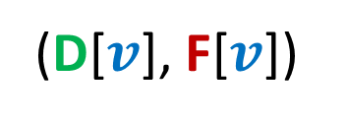
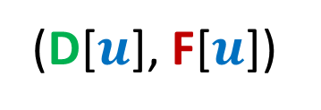








Relation between
(D[$u$], F[$u$])
and
(D[$v$], F[$v$])
Disjoint
One enclosing another
What about
D[$u$]
F[$u$]
D[$v$]
F[$v$]
D[$u$]
F[$u$]
D[$v$]
F[$v$]
D[$u$]
F[$u$]
D[$u$] < D[$v$] <F[$u$] < F[$v$] ?
D[$v$]
F[$v$]
This is because of recursive nature of DFS traversal.

Slide 6

There seem to be many different types of non-tree edges.
x
y
u
s
q
Can we classify the non-tree edges ?
w
j
r
p
v
t
b
d
h
c

Slide 7
Classification of non-tree edges
using
(D[$u$], F[$u$])
and
(D[$v$], F[$v$])

Slide 8









($u$,$v$) is Forward edge
$$u$$
$$s$$
$$w$$
$$v$$
D[$u$]
F[$u$]
D[$v$]
F[$v$]

Slide 9
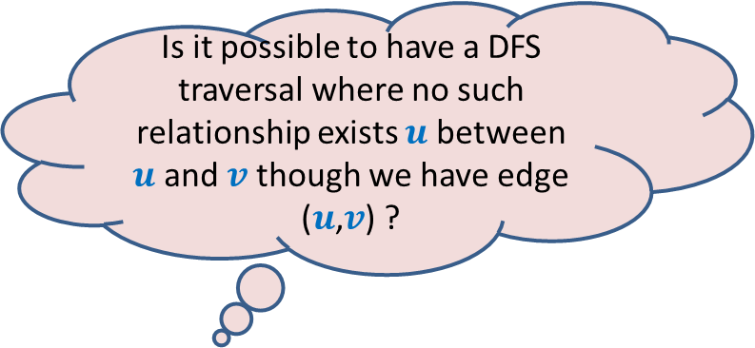








($u$,$v$) is Backward edge
Till now, we considered the cases in which either $u$ is ancestor of $v$ or vice versa.
$$v$$
$$s$$
Is it possible to have a DFS traversal where no such relationship exists $u$ between $u$and $v$ though we have edge ($u$,$v$) ?
$$w$$
$$u$$
Yes, indeed.
Think over it before moving to the next slide
D[$v$]
F[$v$]
D[$u$]
F[$u$]

Slide 10











($u$,$v$) is Cross edge
$$y$$
$$u$$
$$v$$
Is there any other type of non-tree edge ?
Think over it …
$$s$$
$$w$$
In the following slide, we shall show that these are the only possibilities of a non-tree edge.
$$x$$
D[$v$]
F[$v$]
D[$u$]
F[$u$]

Slide 11








Classification of non-tree edges
Consider an edge ($u$,$v$)
Case 1: $u$must be ancestor of $v$
Case 2: $u$must be descendant of $v$
Case 3:
Case 4:
➔ Tree edge or Forward edge
D[$u$]
F[$u$]
D[$v$]
F[$v$]
D[$v$]
F[$v$]
➔ Backward edge
D[$u$]
F[$u$]
Since (D[$u$], F[$u$]) and (D[$v$], F[$v$]) are
either disjoint or one of them encloses the other,
there are only $4$ possibilities.
Cross edge
D[$v$]
F[$v$]
D[$u$]
F[$u$]
D[$u$]
F[$u$]
D[$v$]
F[$v$]

Slide 12
Classification of non-tree edges
x
Homework:
Classify each non-tree edge in this picture.
y
u
s
q
w
j
r
p
v
t
b
d
h
c

Slide 13
Classification of non-tree edges
x
Forward edges
(u,w)
(b,c)
y
u
s
q
w
j
r
p
v
t
b
d
h
c

Slide 14
Classification of non-tree edges
x
Forward edges
(u,w)
(b,c)
Backward edges
(t,u)
(j,u)
(r,q)
(c,b)
y
u
s
q
w
j
r
p
v
t
b
d
h
c

Slide 15
Classification of non-tree edges
x
Forward edges
(u,w)
(b,c)
Backward edges
(t,u)
(j,u)
(r,q)
(c,b)
Cross edges
(x,u)
(j,t)
(y,u)
(y,q)
y
u
s
q
w
j
r
p
v
t
b
d
h
c

Slide 16
Application - II
Computing Strongly connected components of a directed graph.

Slide 17


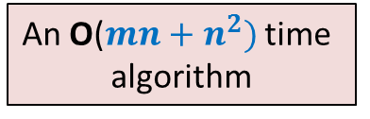
Strongly connected components
Definition: Two vertices $u$ and $v$ are said to be strongly connected if
$u$ is reachable from $v$
$v$ is reachable from $u$
A strongly connected component:
a maximal subset of “strongly connected vertices”
x
An O($m+n)$ time algorithm
An O($mn+n^{2})$ time
algorithm
y
u
v
q
b
d
w
j
r
p
h
c
t
k

Slide 18

Computing SCCs efficiently
An O$(m+n)$ time algorithm

Slide 19

Kosaraju’s Algorithm
DFS Traversal
A simple but very powerful idea
Mtech IIT KGP
PhD Uni. Pennsylvania
Faculty at John Hopkins University

Slide 20




A simple but very powerful idea
$G$ : the given directed graph
$G^{r}$: the graph $G$ after reversing edge directions;
Let us see whether you can use it in today’s lecture ☺
SCCs of $G$
?
SCCs of $G^{r}$

Slide 21


Observation 1
Consider any path from x to z in $G$.
Let y be any vertex on this path.
What can you infer about y?
There is a path from y to z in $G$.
Can you show existence of a path from z to y in $G$?
x
x
It could be like this.
Or
?
y
z
An SCC
z
There is surely a path from z to x
Just trace this path slowly to build a path from z to y.
since they are strongly connected.

Slide 22
Observation 1
x
x
?
y
z
An SCC
z

Slide 23
Observation 1
x
x
y
z
An SCC
z

Slide 24
Observation 1
For a path that starts at a vertex and terminates at another vertex of the same SCC,
all vertices of the path belong to the same SCC.
Can you use this inference to claim anything about the DFS trees and the SCCs ?
x
z
An SCC

Slide 25
Inference of Observation 1
Notation (root of an SCC):
the vertex of the SCC
which is visited first during the DFS.
r
r
An SCC

Slide 26
Inference of Observation 1
Notation (root of an SCC):
the vertex of the SCC
which is visited first during the DFS.
All vertices of the SCC will be descendants of r in the DFS tree.
There may be vertices from other SCCs that will be descendant of r.
But, the entire SCC appears contiguously in the subtree rooted at r.
See the example on the next slide to internalize these inferences.
r
r
An SCC

Slide 27
Try to spot the roots of SCC in the DFS forest.
x
x
y
y
u
u
v
q
v
q
w
j
w
j
r
p
r
p
Let us analyse the finish time.
Since it worked for topological ordering of a DAG ☺
k
t
k
t
b
b
d
d
h
h
c
What should we do ?
Having seen nice structure of SCCs in the DFS forest, we feel motivated to design an efficient algorithm based on DFS.
But how should we start with ?
If we can find out the roots of SCCs, we can find respective SCCs.
But this appears to be as difficult as computing SCCs.

Slide 28
Study Finish time
u
u
There does not appear to be any order ☹.
v
v
q
q
w
j
w
j
r
p
r
p
t
k
t
k
t w k j v r p q u
Increasing order of F[]

Slide 29
Searching for an order using Finish time
It looks too complex !
SCC A
SCC D
SCC B
Have some perseverance, buddy !
SCC C
Increasing order of F[]
Where might be
the roots of each SCC ?
Let us analyse the finish time.
Of the roots of SCCs. May be there exists some order there !

Slide 30




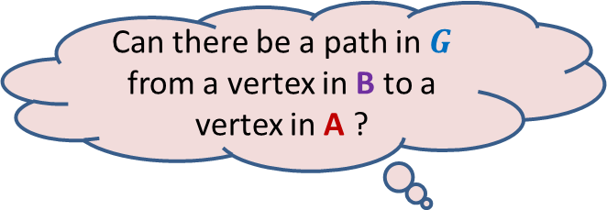
DFS on Directed Graph Analyzing the finish time of roots of SCCs
F[root($\text{A}$)] ? F[root($\text{B}$)]
Can there be a path in $G$ from a vertex in B to a vertex in A ?
So DFS of B will finish before DFS of A begins
No. since such a path would imply that
A and B together form a single SCC.
$$u$$
$$v$$
$$\text{A}$$
$$\text{B}$$
>
Notes:
No. since such a path would imply that A and B together form a single SCC.

Slide 31


DFS on Directed Graph Analyzing the finish time of roots of SCCs
F[root($\text{A}$)] ? F[root($\text{B}$)]
SCC $\text{B}$ is bound to be traversed during DFS( )
$$u$$
$$v$$
$$\text{A}$$
$$\text{B}$$
>

Slide 32

DFS on Directed Graph Analyzing the finish time of roots of SCCs
Lemma 3: Let $\text{A}$& $\text{B}$ be any two SCCs. If there is an edge ($u$,$v$) with $u∈A$ & $v∈B$,
then
F[root($\text{A}$)] > F[root($\text{B}$)]
$$u$$
$$v$$
$$\text{A}$$
$$\text{B}$$

Slide 33

DFS on Directed Graph Analyzing the finish time of roots of SCCs
Lemma 3: Let $\text{A}$& $\text{B}$ be any two SCCs. If there is an edge ($u$,$v$) with $u∈A$ & $v∈B$,
then
F[root($\text{A}$)] > F[root($\text{B}$)]
➔ If F[root($\text{A}$)] < F[root($\text{B}$)], there cannot be any edge from $\text{A}$ to $\text{B}$.

Slide 34
Searching for an order using Finish time
SCC A
NEVER
SCC B
Increasing order of F[]
Can there be an edge from some vertex of A to some vertex of B ?

Slide 35
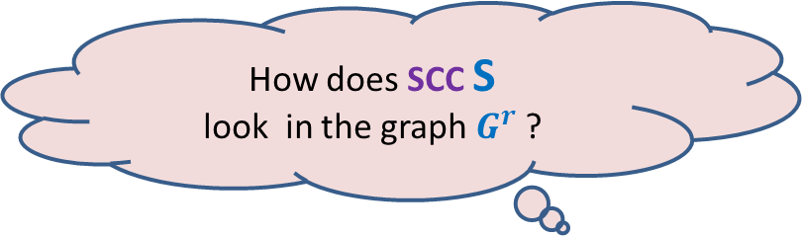




Searching for an order using Finish time
What can we infer for the vertex with max finish time ?
$$u$$
SCC S
$$u$$
SCC S
There won’t be any edge from some vertex outside S into S in $G$.
Time to use the !dea of $G^{r}$.
Get ready.
How does SCC S
look in the graph $G^{r}$ ?

Slide 36



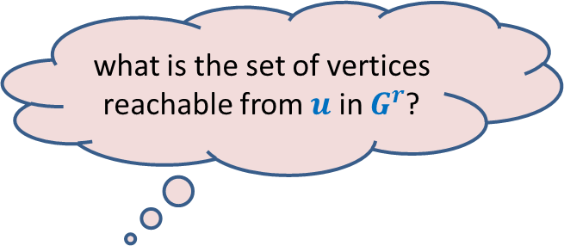

what is the set of vertices reachable from $u$ in $G^{r}$?
$$u$$
Answer: SCC of $u$.
Can you see an algorithm for computing SCCs now ?
It is just here … ☺
Picture in $G^{r}$
SCC S
$$u$$
SCC S
There won’t be any edge from any vertex in S to any vertex outside S in $G^{r}$.

Slide 37
Algorithm for computing SCCs
SCC A
SCC D
SCC B
SCC C
How should we compute SCCs ?

Slide 38



Algorithm for computing SCCs
Execute BFS or DFS on $x$ in $G^{r}$
Remove SCC C
So, how to proceed ?
$$x$$
SCC C
The reachability information of the rest of the graph $G^{r}$ remains unchanged.
This is because there was no outgoing edge from SCC C that we just removed.

Slide 39


Algorithm for computing SCCs
Execute BFS or DFS on $x$ in $G^{r}$
Remove SCC C
Execute BFS or DFS on $y$ in $G^{r}$
Remove SCC D
SCC D
$$y$$

Slide 40


Algorithm for computing SCCs
Execute BFS or DFS on $x$ in $G^{r}$
Remove SCC C
Execute BFS or DFS on $y$ in $G^{r}$
Remove SCC D
Execute BFS or DFS on $z$ in $G^{r}$
Remove SCC B
$$z$$
SCC B

Slide 41

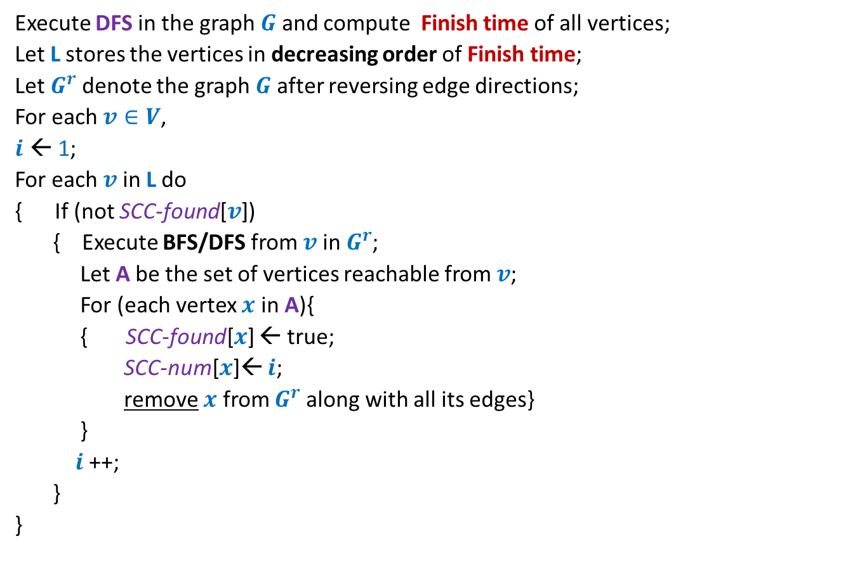
Algorithm for computing SCCs
Execute DFS in the graph $G$ and compute Finish time of all vertices;
Let L stores the vertices in decreasing order of Finish time;
Let $G^{r}$denote the graph $G$ after reversing edge directions;
For each $v∈V$,
$i$ ← 1;
For each $v$ in L do
{ If (not SCC-found[$v$])
{ Execute BFS/DFS from $v$ in $G^{r}$;
Let A be the set of vertices reachable from $v$;
For (each vertex $x$ in A){
{ SCC-found[$x$] ← true;
SCC-num[$x$]← $i$;
remove $x$ from $G^{r}$along with all its edges}
}
$i$ ++;
}
}
SCC-found[$v$]
← false ;

Slide 42
SCC graph of $G$
This should convince you about the importance of the linear time algorithm for SCC that we discussed.

Slide 43
SCC graph of $G$

Slide 44


SCC graph
x
{x,y}
y
u
v
q
{u,v,w,j}
{p,q,r}
w
j
r
p
{t}
{k}
t
k
{b,c,d}
b
d
h
{h}
c
$$G$$
SCC graph of $G$

Slide 45
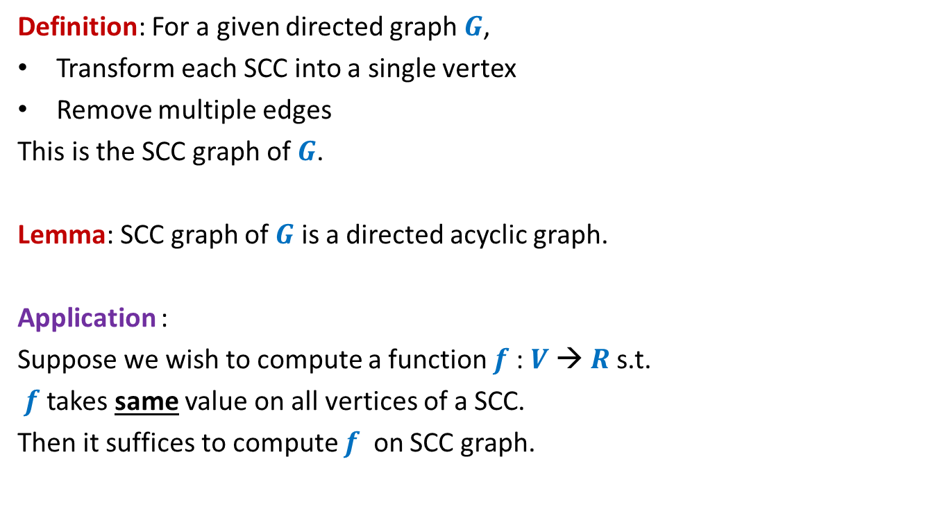
SCC graph
Definition: For a given directed graph $G$,
Transform each SCC into a single vertex
Remove multiple edges
This is the SCC graph of $G$.
Lemma: SCC graph of $G$ is a directed acyclic graph.
Application :
Suppose we wish to compute a function $f$: $V$→ $R$s.t.
$f$ takes same value on all vertices of a SCC.
Then it suffices to compute $f$ on SCC graph.

Slide 46
Other Applications of DFS
Applications:
Checking if a graph is Eulerian.
Maximum flow,
Matching,
…

